Slide 1
Techno Main Salt Lake
Name: Shreyash Lal
University Roll: 13030824012
Paper Name: Data Structures And Algorithms
Paper Code: PCCCS301
Dept: CSE(AI & ML)
Sem: 3rd

Slide 2

Stacks: Operations and Applications
Demystifying a Fundamental Data Structure

Slide 3

What is a Stack?
A stack is a fundamental linear data structure that follows a specific order in which operations are performed. Think of it like a pile of plates: you can only add a new plate to the top, and you can only remove the topmost plate.
LIFO Principle
Simple Visual
Last In First Out
This means the element added most recently is the first one to be removed.
Visualizing the stack as a vertical structure helps in understanding its behavior.

Slide 4

Core Stack Operations
Stacks have a limited set of operations, ensuring their integrity and adherence to the LIFO principle.
1
Push
Adds an element to the top of the stack.
stack.push(item)
2
Pop
Removes and returns the element from the top of the stack.
stack.pop()
3
Peek / Top
Returns the top element without removing it.
stack.peek()
4
isEmpty
Checks if the stack contains any elements (returns true or false).
stack.isEmpty()

Slide 5

Implementing Stacks
Stacks can be implemented using various underlying data structures, each with its own performance characteristics.
Using Arrays
Using Linked Lists
A stack can be implemented using a dynamic array. Elements are added and removed from one end (the "top").
Each element is a node, and the "top" of the stack is the head of the linked list.
Push: O(1)
Push: O(1) (amortized)
Pop: O(1)
Pop: O(1)
Both implementations offer efficient O(1) time complexity for core operations, making stacks a fast choice for many applications.

Slide 6
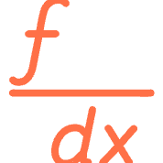



Real-World Applications
Stacks are integral to many computing processes, from everyday software to complex algorithms.
Expression Evaluation
Undo/Redo Functionality
Used in compilers and interpreters for evaluating arithmetic expressions (e.g., converting infix to postfix notation).
Many applications use stacks to store previous states, allowing users to undo or redo actions.
Backtracking
Recursion
Algorithms that explore multiple paths (like solving mazes or finding solutions in games) use stacks to keep track of previous choices.
Recursive function calls implicitly use a call stack to manage function contexts and return addresses.

Slide 7
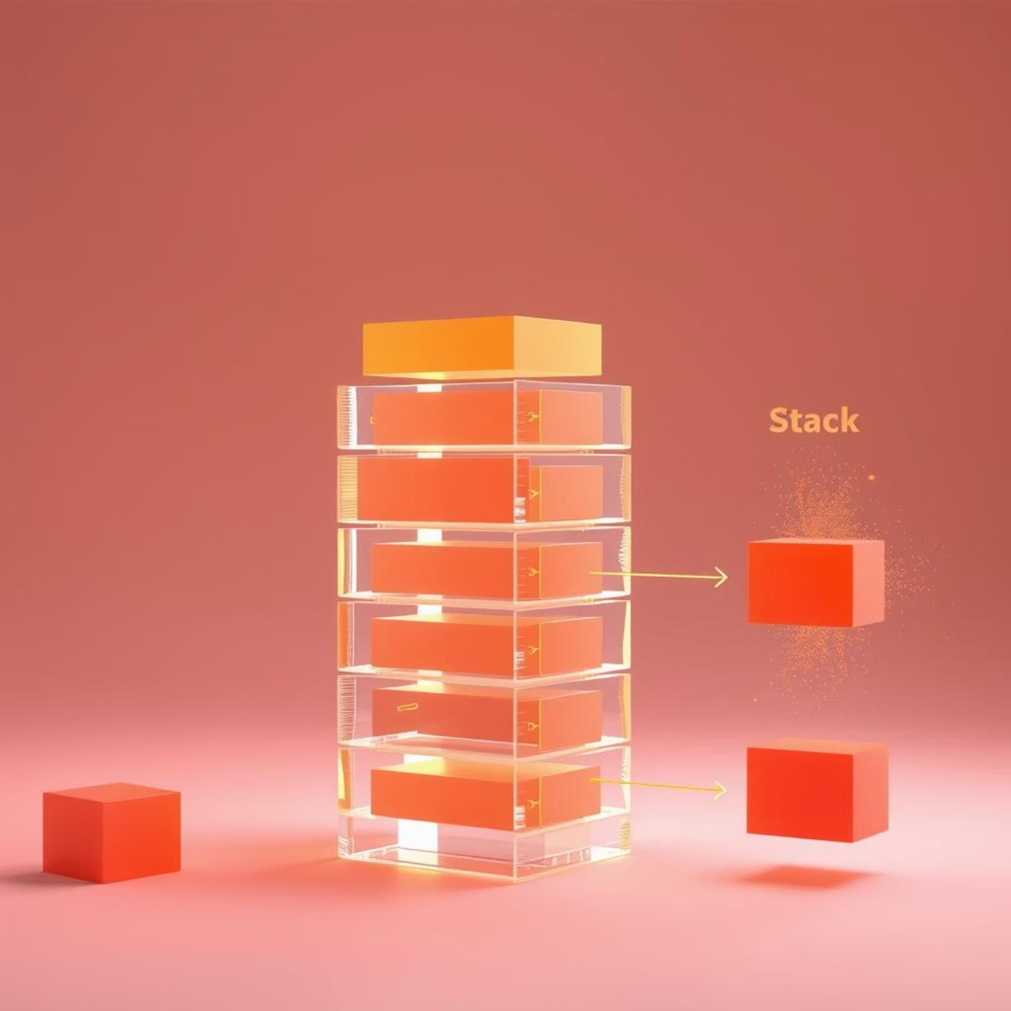
Problem: Valid Parentheses
How do we check if a string of parentheses is valid (e.g., "()[]{}" is valid, but "([)]" is not)?
The Stack Solution
Iterate through the string.
If an opening bracket ((, [, {) is found, push it onto the stack.
If a closing bracket (), ], }) is found:
Check if the stack is empty or if the top element doesn't match the corresponding opening bracket.
If they match, pop the top element.
Otherwise, the string is invalid.
After iterating, if the stack is empty, the string is valid.

Slide 8
Key Takeaways
Stacks are intuitive yet powerful. Understanding their behavior is crucial for efficient algorithm design.
1
LIFO is the defining principle.
2
Push, Pop, and Peek are core operations.
3
Efficiently implemented with arrays or linked lists.
4
Versatile in programming and real-world applications.

Slide 9
Further Reading & Resources
Textbooks:
Cormen, T. H., Leiserson, C. E., Rivest, R. L., & Stein, C. (2009). Introduction to Algorithms (3rd ed.). MIT Press.
Goodrich, M. T., Tamassia, R., & Goldwasser, M. H. (2014). Data Structures and Algorithms in Java (6th ed.). Wiley.
Online Resources:
GeeksforGeeks - Stack Data Structure
Programiz - Stack Data Structure
Research Papers:
Knuth, D. E. (1997). The Art of Computer Programming, Volume 1: Fundamental Algorithms (3rd ed.). Addison-Wesley Professional.

Slide 10
Thank You!

